Slide 1


JavaScript Scope, Hoisting, Closure
ALL ABOUT SCOPE

Slide 2
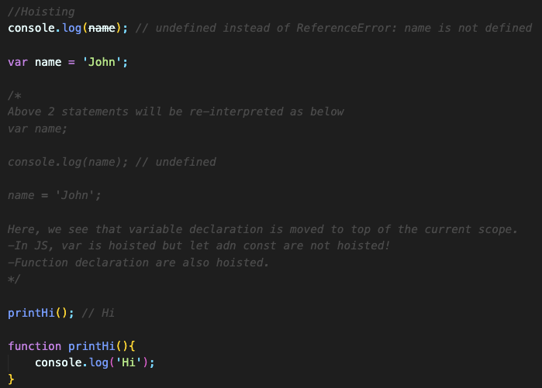
Hoisting
Hoisting is a concept in JavaScript that allows you to use functions and variables before they're declared.
This is because the JavaScript interpreter moves declarations to the top of their containing scope before execution.
This process is called hoisting.
RULE: To avoid bugs, always declare all variables at the beginning of every scope.

Slide 3
Scope in JavaScript
Scope determines the accessibility (visibility) of variables, objects, and functions.
JavaScript has 4 types of scope:
Global scope
Function scope
Block scope (ES6)
Lexical Scope (ES6 - Closure)

Slide 4
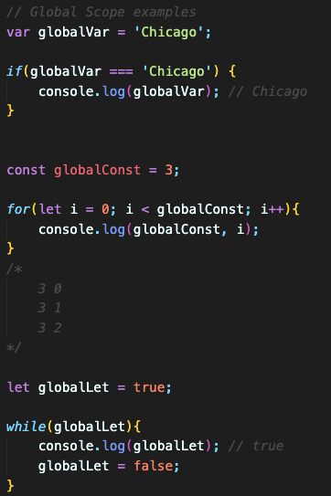
Global Scope
Variables declared globally (outside any function) have Global Scope.
Global variables can be accessed from anywhere in the program.
Variables declared with var, let and const are quite similar when declared outside a block.

Slide 5
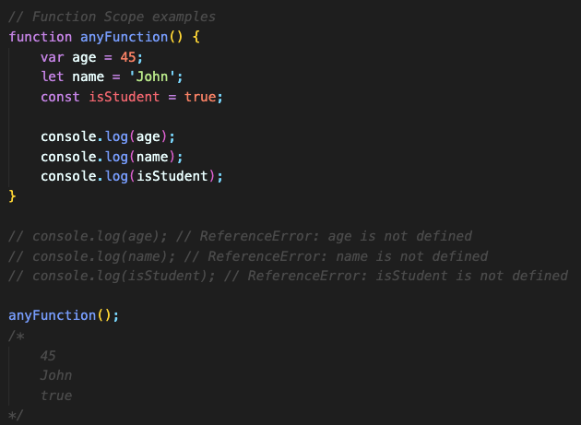
Function Scope
Variables declared within a JavaScript function, become LOCAL to the function.
They can't be used outside the function.
Variables declared with var, let and const are similar when declared inside a function considering the scope.

Slide 6
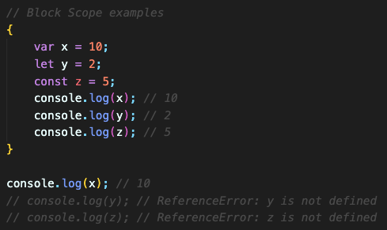
Block Scope
JavaScript had only Global Scope and Function Scope before ES6 (2015).
Variables declared with the var keyword can NOT have block scope.
ES6 introduced two important new JavaScript keywords: let and const.
These two keywords provide Block Scope in JavaScript.
Variables declared inside a { } block with let or const cannot be accessed from outside the block.

Slide 7
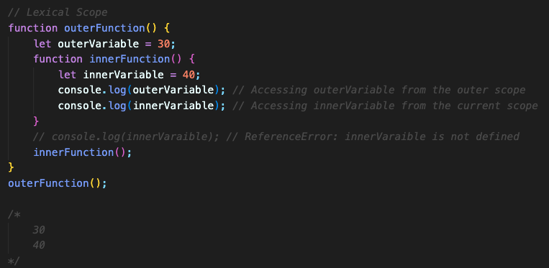
Lexical Scope
Used in case of nested functions and defines the accessibility of variables for inner and outer functions.
In simple terms, lexical scope means that a variable or function can only be accessed within the scope in which it is defined.
The scope of a variable or function is determined by its position in the source code.

Slide 8
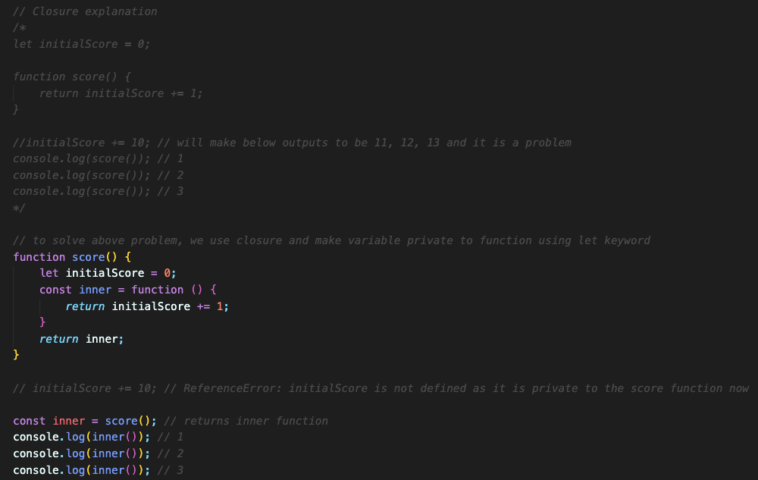
Closure
A closure in JavaScript is a function that has access to variables from its containing (enclosing) function.
It makes it possible for a function to have "private" variables.
These private variables can only be changed using inner functions.

